Slide 1

Over the rainbow...
are we going into the RIGHTS direction?

Slide 2
About the Topic
Notes:
People have been historically subjected to stigma and discrimination, depending on their sexual preferencies.
Even nowadays many people feel the need to hide being LGBTI to avoid discrimination, hate or even violence.

Slide 3
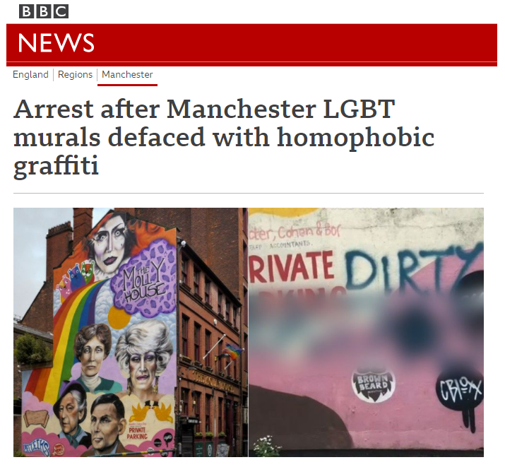
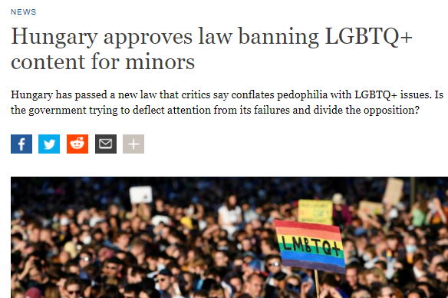
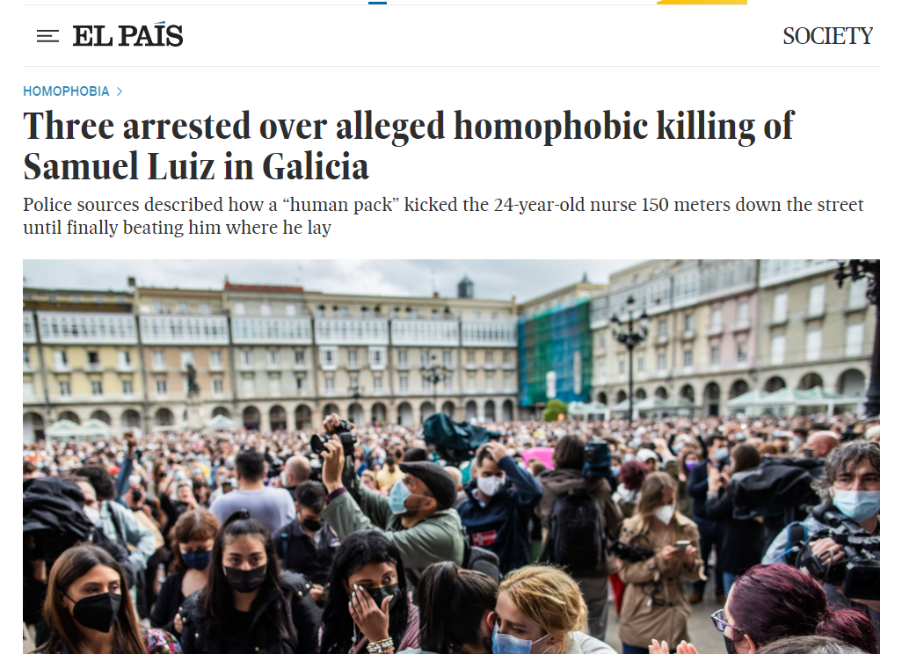

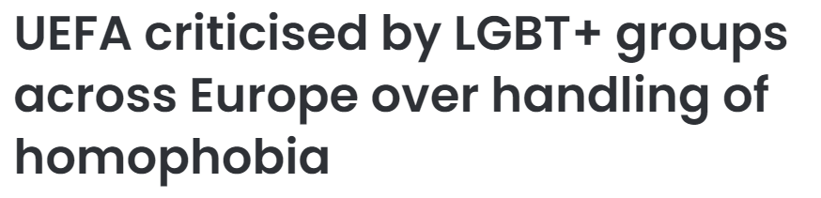
News related with homophobia are increasing worldwide
Notes:
Everyday there are news related to homophobia: in the church, through the laws, against cultural representations, in the streets and at sports…
With this analysis I would like to provide figures that show the evolution in this field.

Slide 4
The “Dataset”

Slide 5

The Survey
EU LGBTI Survey
Largest survey in EU about LGBTI people
2012 | 2019
93,079 respondents | 139,799 respondents
www.lgbtisurvey.eu
Notes:
The Data has been extracted from the European Union Agency for Fundamental Rights (FRA) and it is biggest survey in the world about LGBTI people in EU.
The survey collects personal experiences and perceptions about discrimination and hate across different areas of life.
Till now they have release 2 editions, and the number of participants has increased 50%. But collected information is in percentages so answers are comparable.
The groups included in the survey are lesbians, gays, bisexuals, transgender people and intersex, but due to lack of comparison with 2012, the group intersex is not included in this analysis.

Slide 6
The Survey | Focus on
SURVEY SECTIONS | DISCRIMINATION TOPICS | COUNTRIES COVERED
Public perceptions trends Discrimination Right awareness Safe environment Physical/sexual violence Harassment Social Context | General approach Specific topics: School Work Healthcare | Austria Belgium Bulgaria Croatia Cyprus Czechia Denmark Estonia Finland France Germany Greece Hungary Ireland Italy | Latvia Lithuania Luxembourg Malta Netherlands North Macedonia Poland Portugal Romania Serbia Slovakia Slovenia Spain Sweden United Kingdom
Notes:
The survey analyzes different aspects, but I have focuses on the Discrimination Section, that covers:
A general part about daily life and after goes deeper into specific topics like: discrimination at school, at work or by healthcare services.
To make an easy comparison about the evolution, I have choose 3 countries:
Finland, expected to be one of the progressive countries. More than 3,400 vs 4,700
Hungary, where homophobic behavior of the government put them at risk of being expelled from the European Union. The participation in 2nd survey has DOUBLED (+4,000)
Spain, my hometown, with the highest participation of the study with more 20,000 answers.

Slide 7

General approach to discrimination
Notes:
Let’s go in deep to a general approach to discrimination through the question:
During the last 12 months, have you felt discriminated against because being LGBT in any of the following situations?

Slide 8
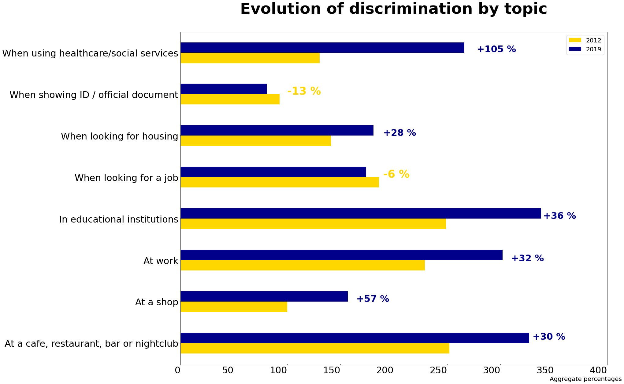
Global evolution of discrimination | by topic
Notes:
Globally we see that:
Perception of discrimination decrease when showing ID and when looking for a job, BUT
*******
Increase a lot in Healthcare and educational institutions.

Slide 9
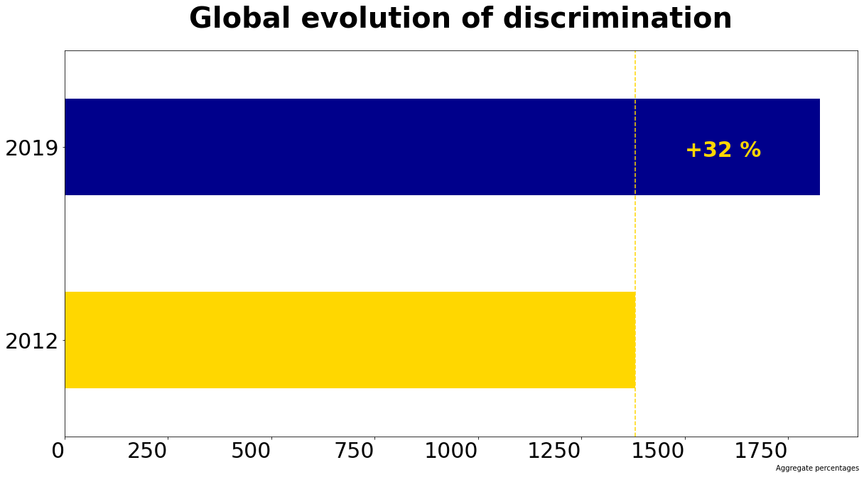


Global evolution of discrimination
Notes:
Aggregating all percentages from the previous slide, we can see that globally, discrimination in 2019 increase 32% respect the previuos survey.
*******
We should do better, don’t you think?

Slide 10
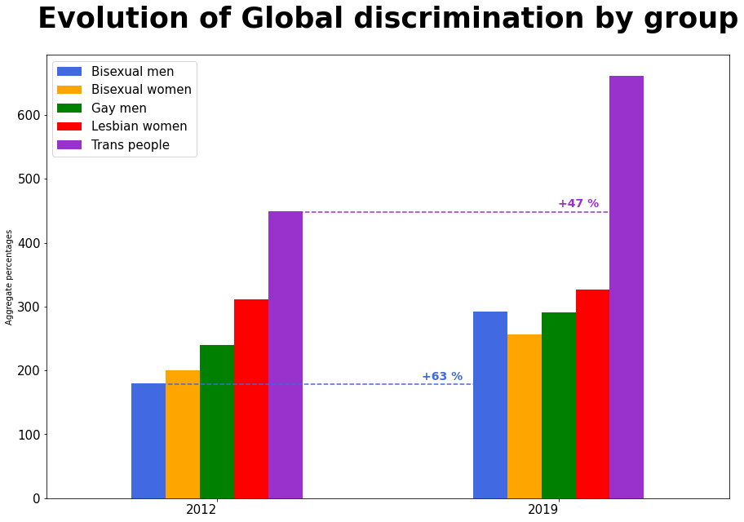
Global evolution of discrimination | by group
Notes:
Regarding to the different studied groups:
Trans people and lesbian are the most discriminated, BUT
Bisexual men perception present the highest increment.

Slide 11
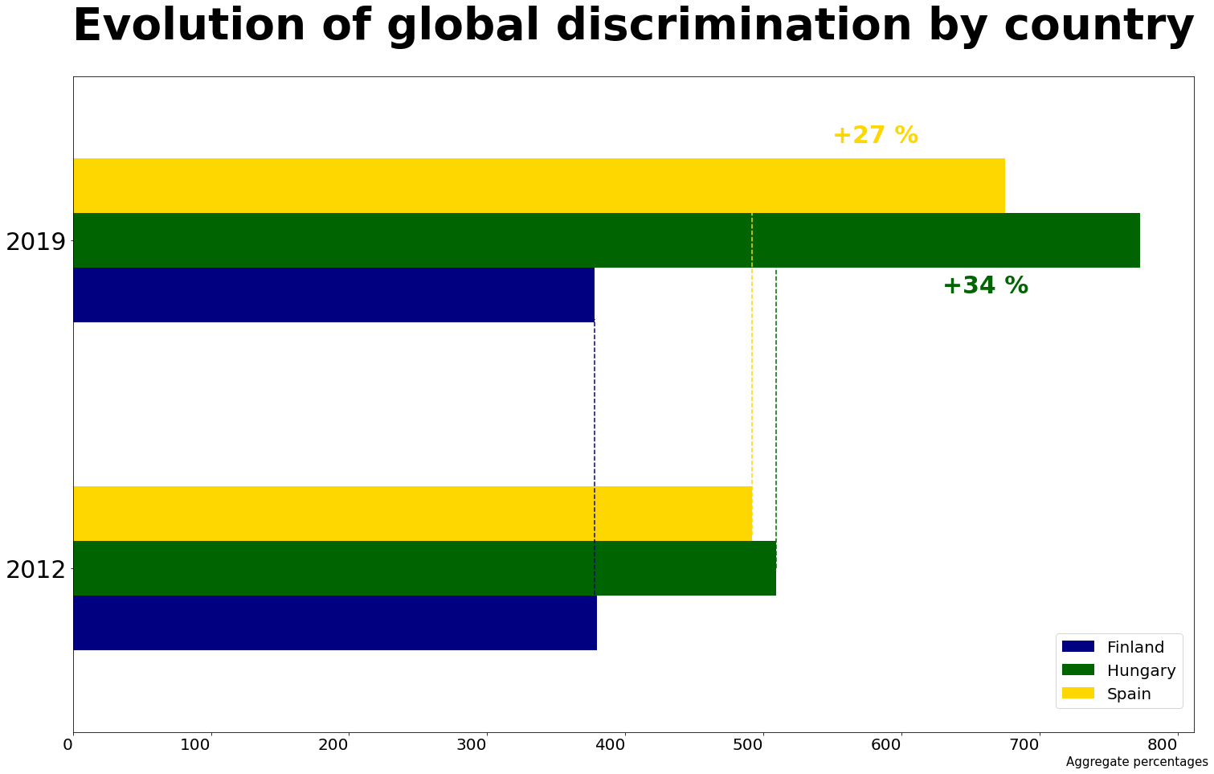
Global evolution of discrimination | by country
Notes:
If we focus on the countries:
Perception of discrimination in Finland remains the same, BUT
In Hungary and Spain the global perception increase.

Slide 12

Discrimination at School
Notes:
We will focus now in the period where participants where at school, through the question:
Did you experience negative comments or conduct because being LGBT?

Slide 13
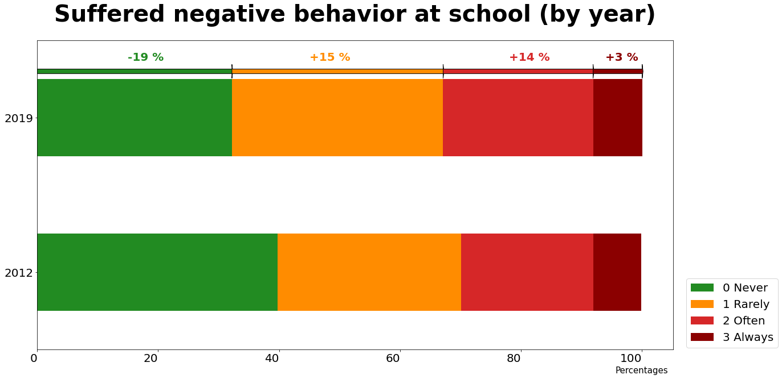
Discrimination at school
Notes:
This graphic shows the distribution of answers per year, that goes from never felt discrimination at school in green, to people that always get discriminated in dark red.
Globally we see that negative experience of people at school is increasing compared to the results of the same question in 2012. ****

Slide 14
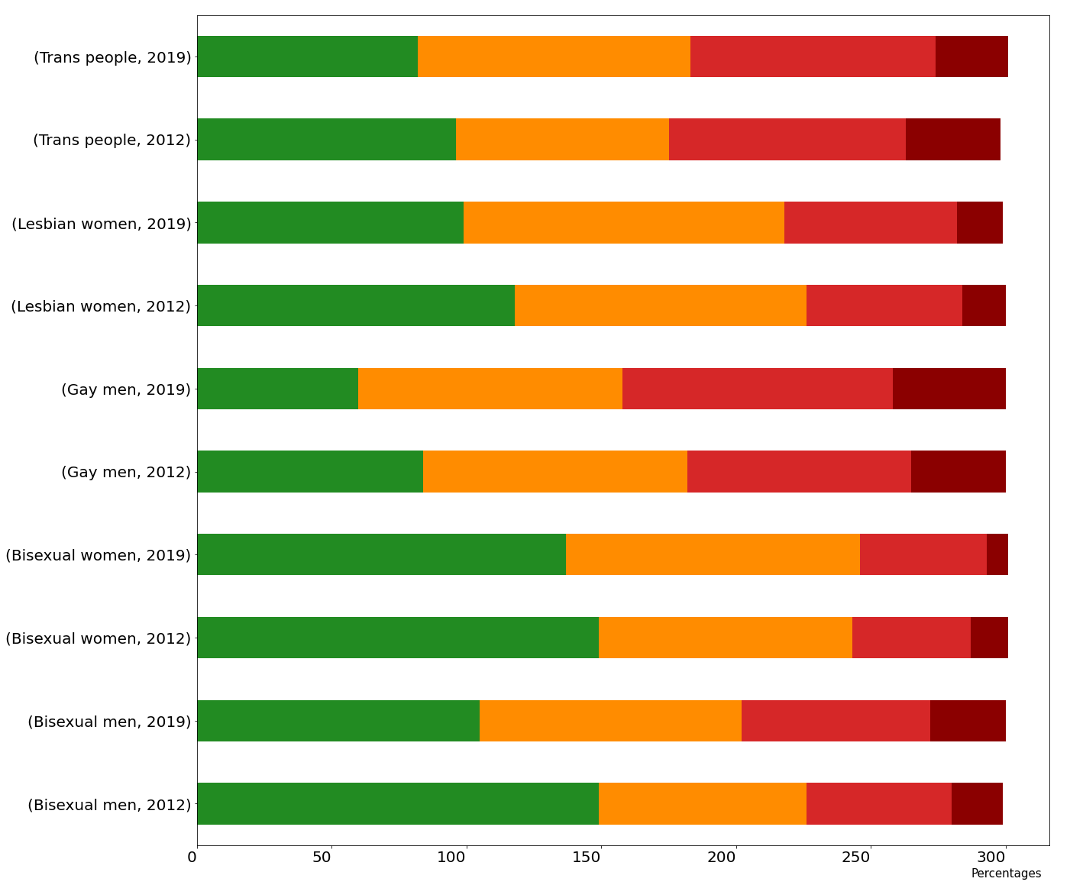
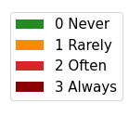
Discrimination at school | by group
Trans
people
2019
2012
Gays are the most discriminated group.
Bisexual women the less discriminated in 2019.
Bisexual men highest increase of discrimination.
Lesbian women
2019
2012
Gay
men
2019
2012
Bisexual women
2019
2012
Bisexual
men
2019
2012
Notes:
Analyzing the results per group of people:
We can conclude that gay men are still the most discriminated group at school,**** where bisexual women are the less. ****
In 2012, bisexuals where the less discriminated groups at school, but in 2019 bisexual men perception of discrimination has increased the most. *****

Slide 15
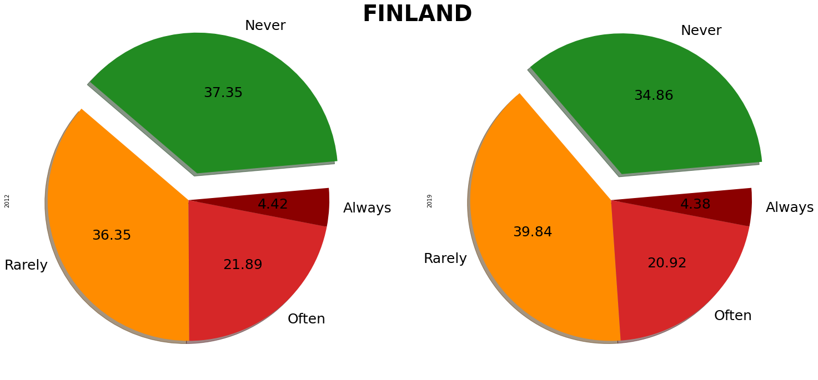
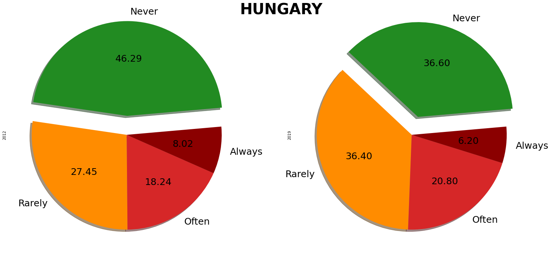
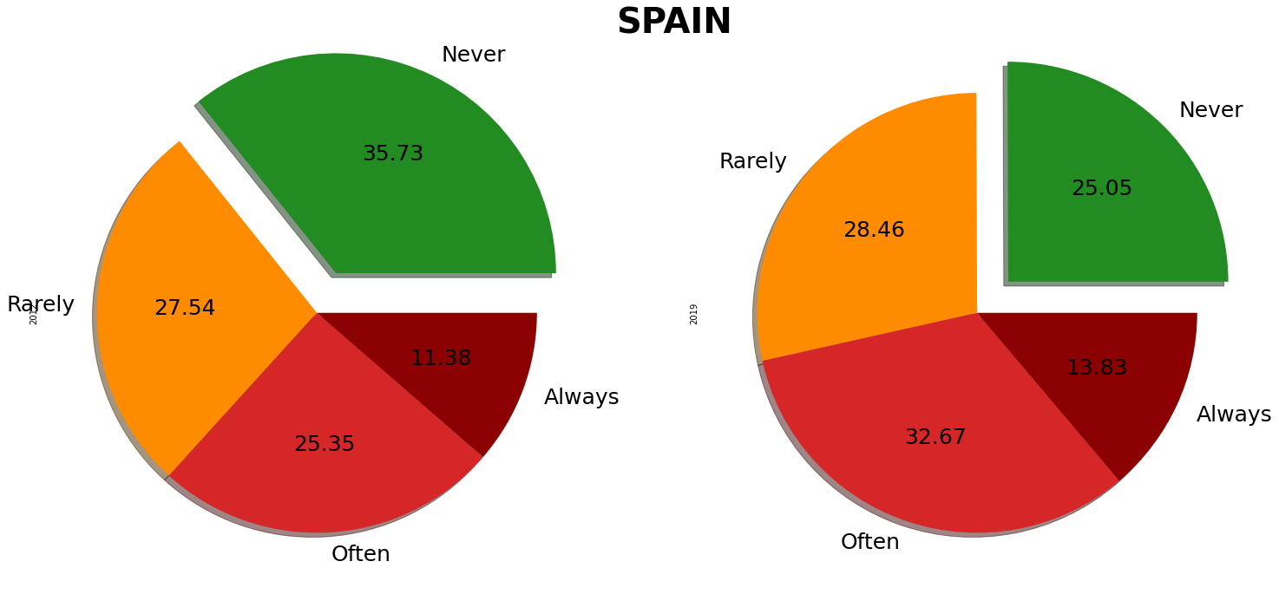
Discrimination at school | by country
Never felt discrimination decrease in all.
Finland Always and Often slightly decrease.
Hungary Always decrease.
Spain increase Often and Always.
Notes:
As we have already seen people that never felt discriminated decrease in all three.
Regarding to the options where discrimination exists:
In Finland the quantity of people who always or often felt discriminated slightly decrease.****
In Hungary decrease the number of people who always get discriminated****
BUT in Spain the progression shows that people who always or often felt discriminated at school has increased.

Slide 16
Discrimination at Work
Notes:
For people who has a job, the survey ask if during the last 5 years,
They have experienced general negative attitude at work against LGBT people

Slide 17
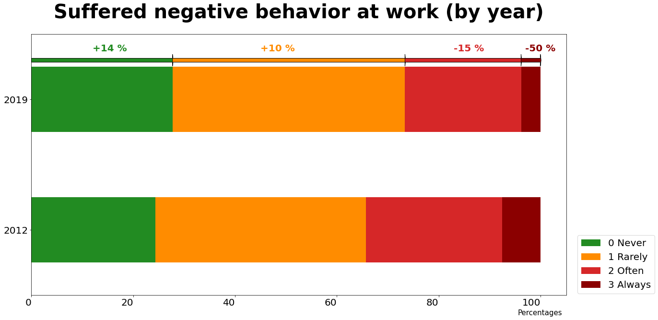
Discrimination at work
Notes:
In this ambit we appreciate a positive evolution, where the people who always perceive negative attitudes at work decrease 50% and people who never or rarely perceive that increase. ***

Slide 18
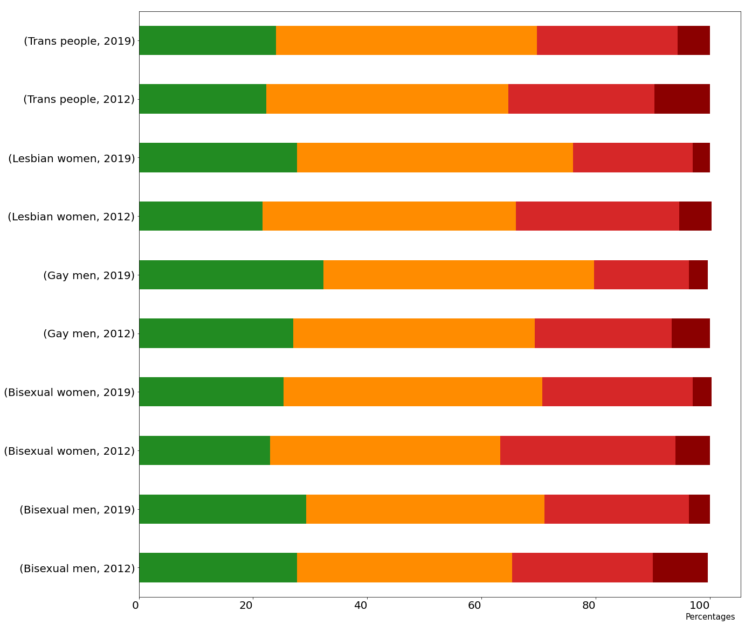
Discrimination at work | by group
Trans
people
Decreasing generally.
Gay and bisexual men are the less discriminated.
Lesbians highest increment of Never.
Transexuals are still the most discriminated.
2019
2012
Lesbian women
2019
2012
Gay
men
2019
2012
Bisexual women
2019
2012
Bisexual
men
2019
2012
Notes:
Discrimination at work is progressively decreasing for all the groups, where:
Gay and bisexual men are the less discriminated group in 2019, ***** and
Lesbians present the highest increment answering “Never” perceive discrimination. ****
In 2019 transgender people continue being the group who more frequently are always discriminated at work. ****

Slide 19
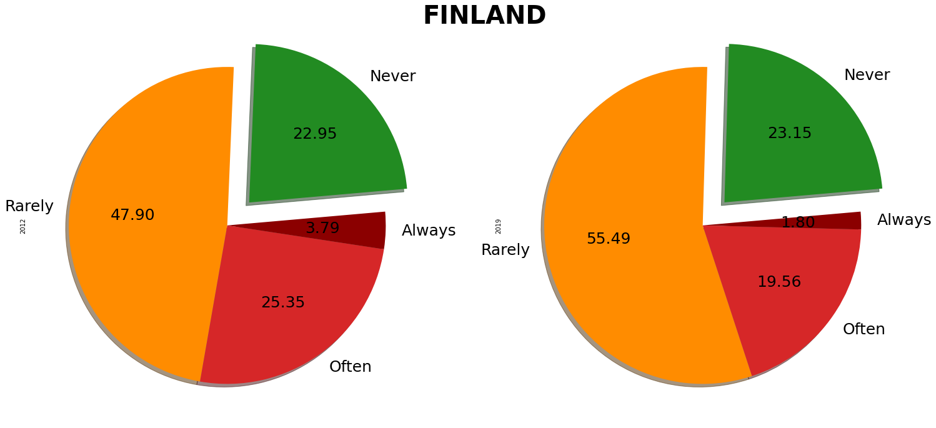
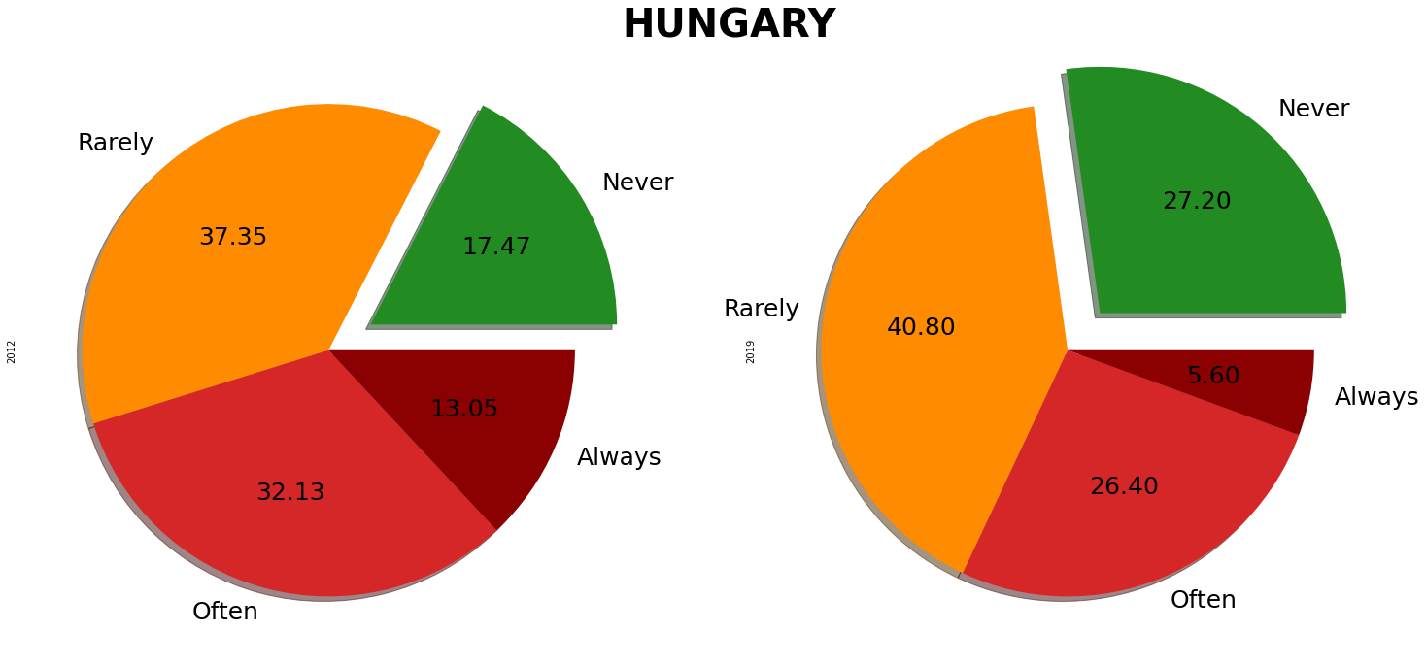
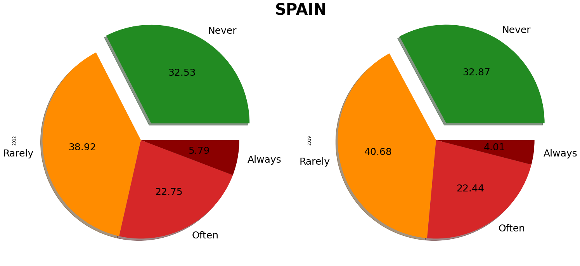
Discrimination at work | by country
Never increase in the 3 countries.
Always discriminated is unlikely in Finland.
Hungary presents the better evolution.
Spain small improvements.
Notes:
A positive evolution can be seen in all countries:
Out of the three, Finland is the country where is less frequent to always perceive discrimination at work.****
Hungary presents the better evolution with the highest increment of people answering “Never” and the highest decrease in answering “Always”. ****
In Spain discrimination at work improves slightly

Slide 20

Discrimination by Healthcare
Notes:
This last section, ask the participants if they have ever experience any uncomfortable situation when using healthcare services

Slide 21
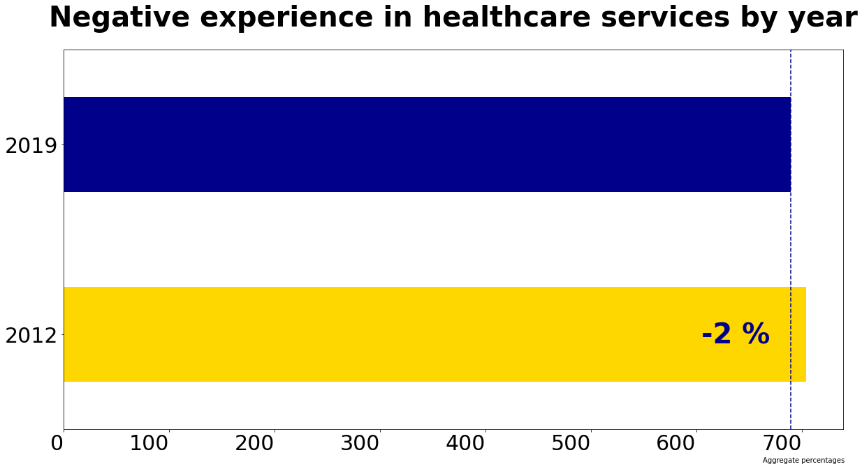
Discrimination by healthcare
¿ ?
Notes:
Globally we see a small improvement, but is that true? ****

Slide 22
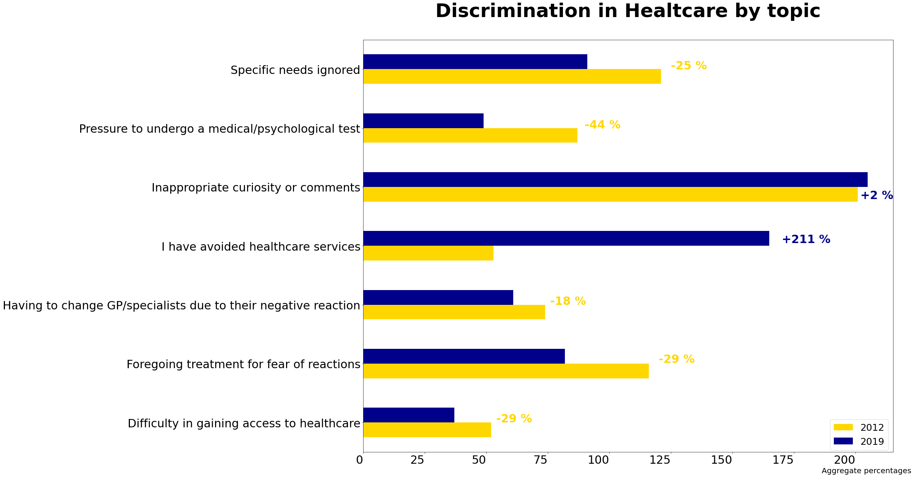
Discrimination by healthcare | by topic
Notes:
If we go in deep, in all topics we see a positive evolution, BUT…..
Inappropriate curiosity or comments are still too frequents, AND***
People who avoid attending to the healthcare services, has increased worryingly

Slide 23
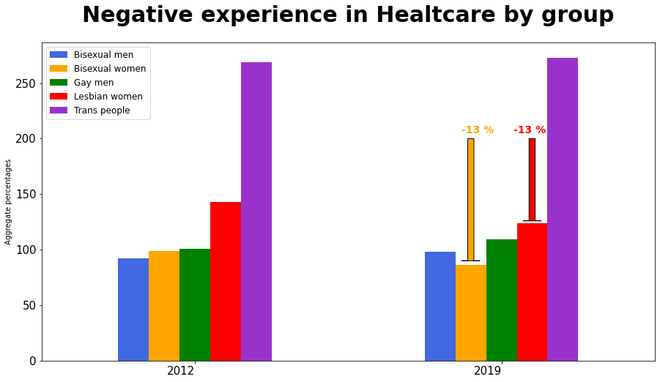
Discrimination by healthcare | by group
Notes:
Regarding to the groups of people, trans gender remain the one with most problems at healthcare ****
On the other side, we appreciate decreasing problems of discrimination for Bisexual women and Lesbian.

Slide 24
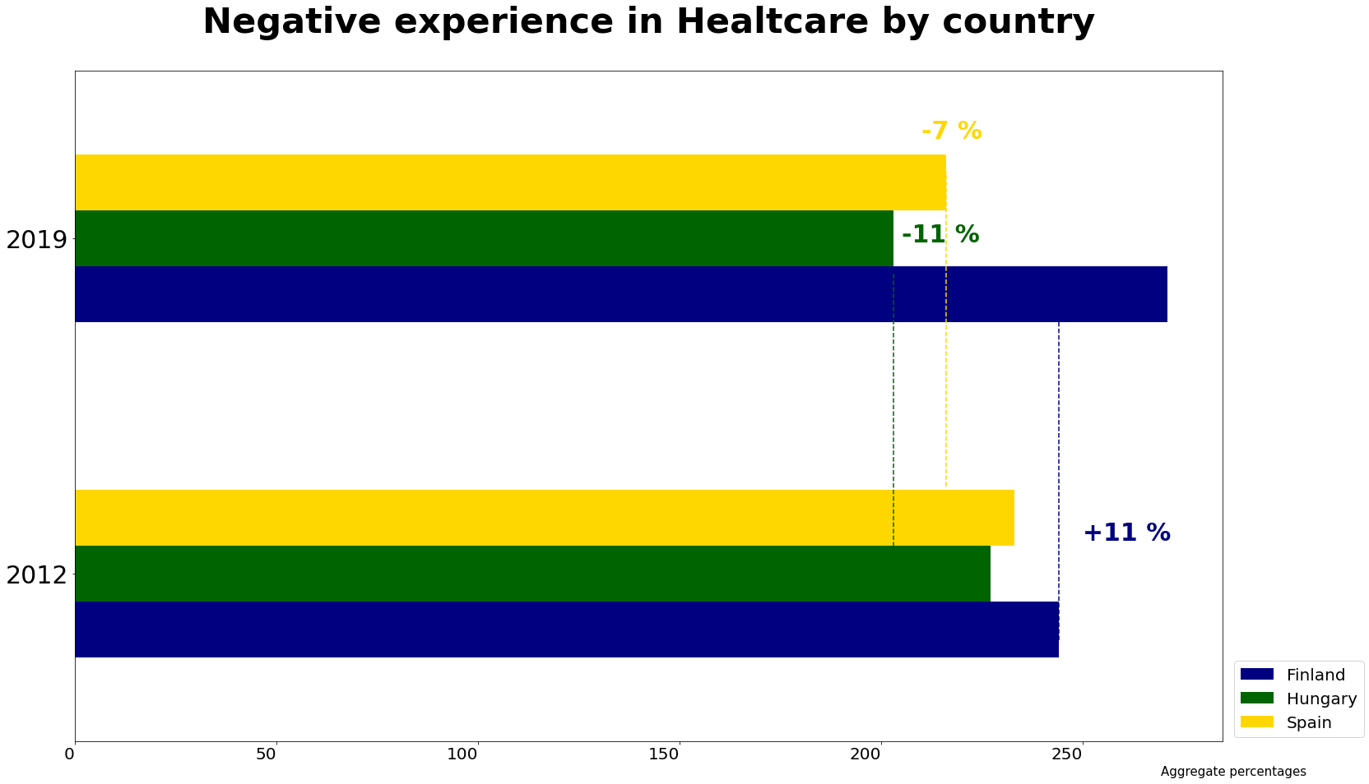
Discrimination by healthcare | by country
Notes:
In the country analysis, we appreciate improvements in Hungary and Spain, but a weird increase in Finland, the country that until now shows better behavior….
So let’s go deeper….

Slide 25
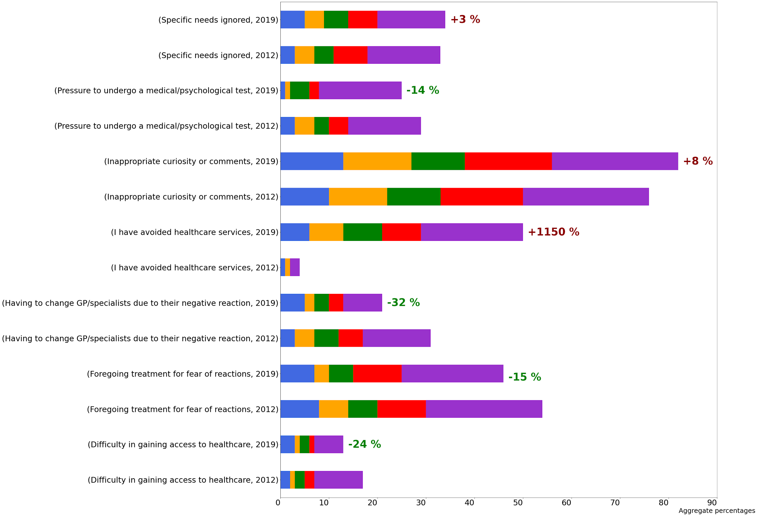
Discrimination by healthcare | by country : Finland
Specific needs ignored
Pressure to undergo medical/psychological test
Inappropriate curiosity
or comments
I avoided healthcare services
Having to change GP/specialist due to their negative reaction
Foregoing treatment for
fear of reaction
Difficulty in gaining
acces to healthcare
Notes:
Globally we appreciate that in Finland most aspects are improving, or remain almost equal, BUT****
“Avoiding accessing healthcare services” has increased amazingly.
This issue was made public in 2018 through Miss Gay Finland, who denounced that most doctors refuse to treat her because her sexual orientation.
https://yle.fi/uutiset/osasto/news/miss_gay_finland_highlights_discrimination_in_health_care/10258983

Slide 26
Conclusions

Slide 27
While things are improving at work, we need to continue working for improving conditions at school and in healthcare.
Trans gender people are the most discriminated generally, followed by lesbians, but at school gay are the most.
Finland seems to be the more respectful country, but they need to focus on improving their healthcare.
Notes:
My intention with this analysis is to makes us all think about, and consider how we can contribute to improve this situation, so don't give up!!

Slide 28



/ marta-santiago
Pride NOT Prejudice
Let’s make EU PRIDE for all
Data Analytics 07/2021
Notes:
Thank you all for your time!

